Slide 1

The Secrets of Salient Object Segmentation
Yin Li -1, Xiaodi Hou -2, Christof Koch -3, James M. Rehg -1, Alan L. Yuille -4
1-Gerogia Institute of Technology, 2-California Institute of Technology,
3-Allen Institute for Brain Science, 4-University of California, Los Angeles
Presented by : Sai Anirudh Kondaveeti
Course : INF 6803 -- Traitements vidéo et applications

Slide 2
Outline
Introduction
Terms and Concepts
Problem in present scenario
Overview
Dataset Analysis
Proposing a new dataset(PASCAL-S)
Evaluating dataset consistency
Benchmarking
Dataset design bias
Fixations and F-measure
Proposed Algorithm
Salient object, object proposal and fixations
The model
Limits of the model
Results
Conclusion

Slide 3
Introduction
Bottom-up visual saliency refers to the ability to select important visual information for further processing.
Fixation prediction
Salient object segmentation
The existing method have two limitations:
Algorithms focusing on one type of saliency tend to overlook the connection to the other side.
Benchmarking primarily on one dataset tend to overt the inherent bias of that dataset.
Discuss the connection between fixation prediction and salient object segmentation. Then discuss dataset design bias , propose a new model of salient object segmentation and then compare it with existing state of art algorithms.
Notes:
In a fixation experiment, saliency is expressed as eye gaze. Subjects are asked to view each image for seconds while their eye fixations are recorded. The goal of an algorithm is to compute a probabilistic map of an image to predict the actual human eye gaze patterns. Patch Based, pixel based feature to extract and then finally a local or global step that renormalize feature saliency values.
In a salient object segmentation dataset, image labellers annotate an image by drawing pixel-accurate silhouettes of objects that are believed to be salient.
Despite the deep connections between the problems of fixation prediction and object segmentation, there is a discomforting isolation between major computational models of the two types. Because of series of differences in ground truth and evaluation procedures. A typical fixation ground truth contains several fixation dots, while a salient object ground-truth usually have one or several positive regions composed of thousands of pixels.
Centre Bias : Subject look more often at the centre of screen. It may be due to chin rest or the photographer bias to centre the objects.

Slide 4
Fixation algorithms
Salient object segmentation Algorithms
Fixation algorithms dataset
Salient object segmentation dataset
ITTI
AIM
GBVS
DVA , etc
FT
GC
SF
PCAS
Judd
Cerf
IS
Bruce
FT
IS
Bruce

Slide 5
Dataset Analysis
PASCAL-S
PASCAL-S dataset is built on the validation set of the PASCAL VOC 2010 segmentation challenge. This subset contains 850 natural images.
In the fixation experiment, 8 subjects were instructed to perform the “freeviewing“ task to explore the images. Each image was presented for 2 seconds, and eye-tracking re-calibration was performed on every 25 images. The eye gaze data was sampled using Eyelink 1000 eye-tracker, at 125Hz.
In the salient object segmentation experiment, we first manually perform a full segmentation to crop out all objects in the image. Then the 12 subjects label them. The final saliency value of each segment is the total number of click it receives, divided by the number of subjects.

Slide 6
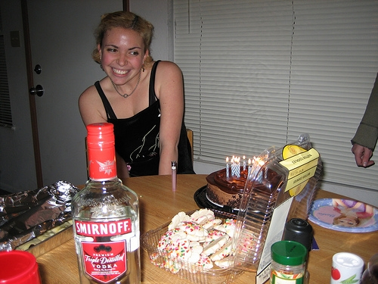

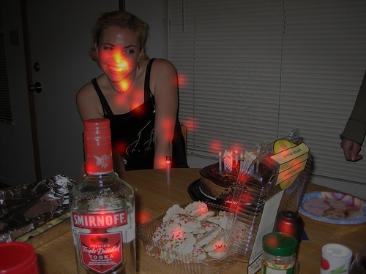

ORIGINAL IMAGE
FULL SEGMENTATION
EYE FIXATIONS
SALIENT OBJECT MASKS

Slide 7
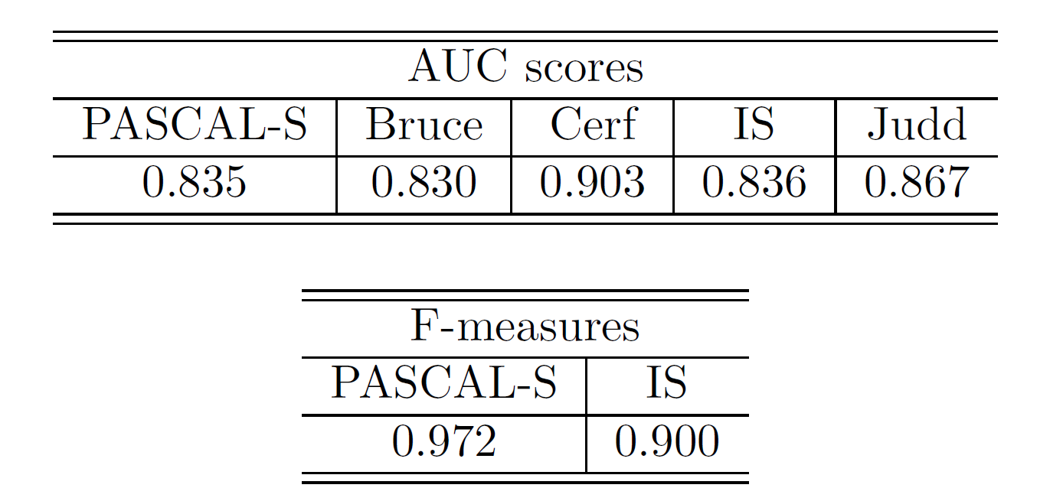
Evaluating dataset consistency
To compare the level of agreement among different labellers in our PASCAL-S dataset and other existing dataset, we randomly select 50% of the subjects as the test subset. Then we benchmark the saliency maps of this test subset by taking the rest subjects as the new ground-truth subset.

Slide 8
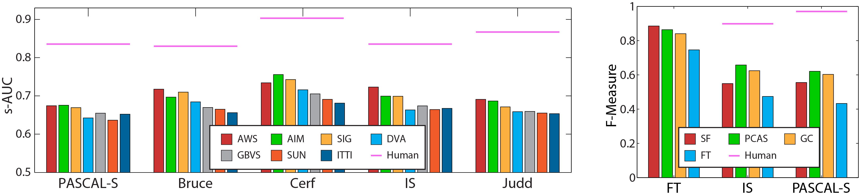
Benchmarking
The purposes of this analysis are:
To highlight the generalization power of algorithms
To investigate inter-dataset difference among these independently constructed datasets
Notes:
The average performance of all 4 algorithms have dropped, from FT's 0:8341, to 0:5765 (30:88% drop) on IS, and 0:5530 (33:70% drop) on PASCAL-S – Segmentation

